Slide 1
Digital Signal Processing
Dr. Michael Nasief
Lec 9

Slide 2
Chapter [7]
FFT

Slide 3
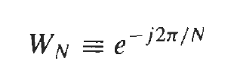
THE DISCRETE FOURIER TRANSFORM
The N -point DFT of an N -point sequence x(n) is
Remember
Remember

Slide 4
The Basic Idea
DFT
x(n) may be complex
So
N times complex multiplication and addition
X(K) --- k from 0 to N-1
So
N times of
N times of N times = N²

Slide 5
The Basic Idea
FFT
Split x(n) by 2 divisions
So
(N/2)² times
So
(N/2)² times
(N/2)² + (N/2)² = 0.5 N²

Slide 6
Decimation-in-Time FFT
Let x(n) be a sequence of length N = 2^{v},
x(n) is split (decimated) into two subsequences, each of length N/2.

Slide 7
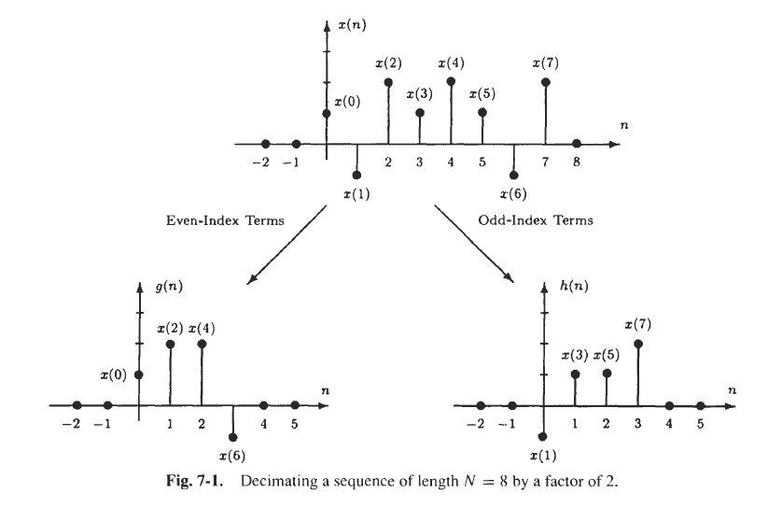

Slide 8
In terms of these sequences, the N -point DFT of x(n) is
Remember

Slide 9
Note

Slide 10
Note that the first term is the N/2-point DFT of g(n), and the second is the N/2-point DFT of h(n):
Remember this later
twiddle factors.

Slide 11
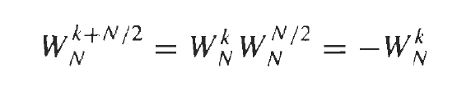
Note

Slide 12
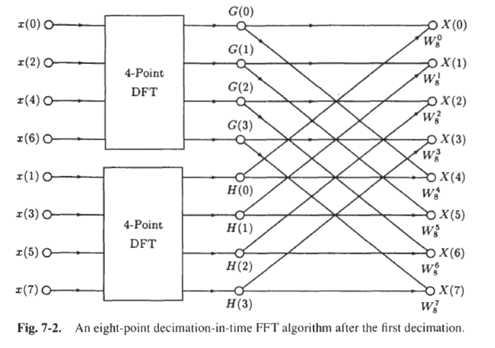

Slide 13
Now Again
If N/2 is even, g(n) and h(n) may again be decimated. For example, G ( k ) may be evaluated as follows:

Slide 14
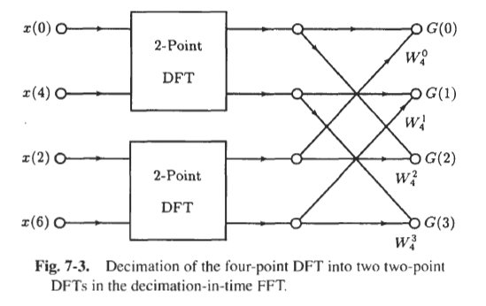
where the first term is the N/4 -point DFT of the even samples of g(n) and the second is the N/4-point DFT of the odd samples.
W₈⁰
W₈²
W₈⁴
W₈⁶

Slide 15
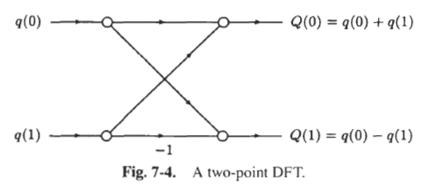
Two-point DFTs of the form shown in Fig. 7-4.
How ?

Slide 16
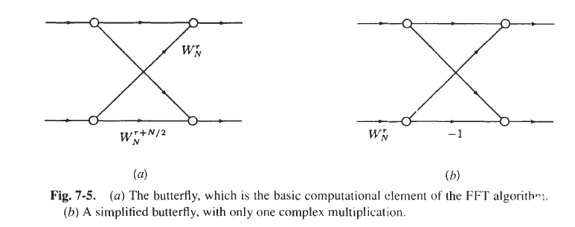
The butterfly
The basic computational unit of the FFT, shown in Fig. 7-5(a), is called a butterfly.

Slide 17
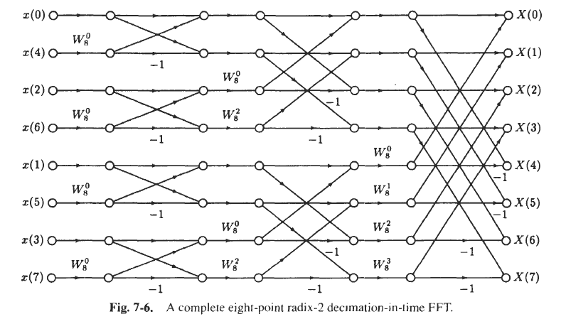
The Final Form

Slide 18
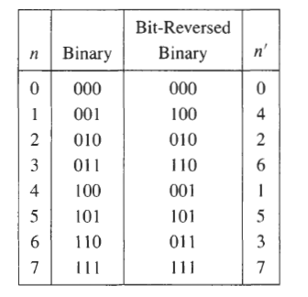
Bit Reversal

Slide 19
Computations Required
Computing an N-point DFT using a radix-2 decimation-in-time FFT is much more efficient than calculating the DFT directly.
Log₂ N stages
N/2 complex multiplies by the twiddle factors and N complex additions.
Total of N/2 Log₂ N complex multiplications and
N log₂ N complex additions.

Slide 20
Sheet (7) FFT
Problems
1,3,4

